Slide 1
CS-Studio at SNS
Kay Kasemir
July 2026

Slide 2
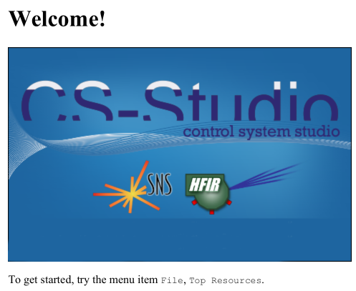

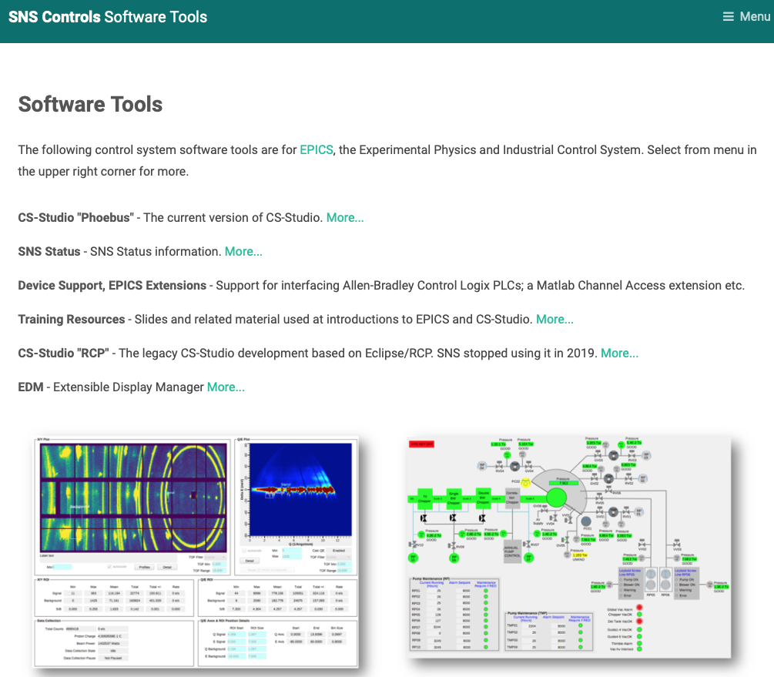
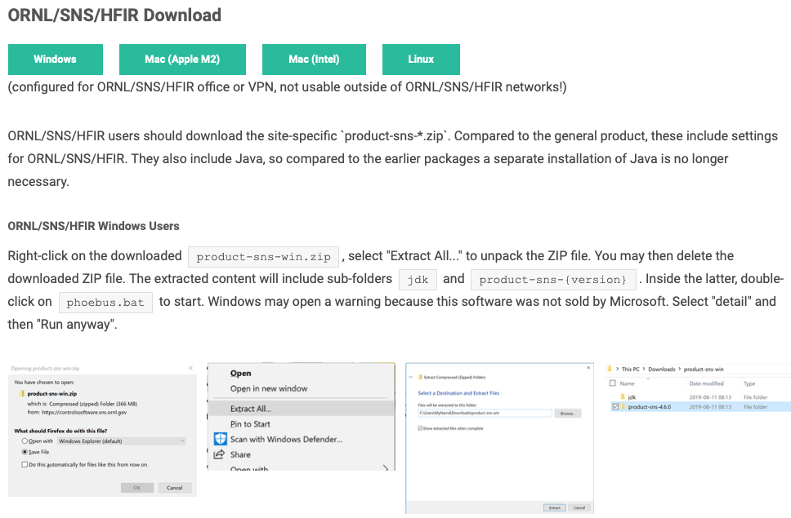
SNS Version of CSS
Provided in Central Control Room and at Beamlines
For read-only usage from ORNL network (your office):
  https://controlssoftware.sns.ornl.gov → CS-Studio → ORNL/SNS/HFIR

Slide 3
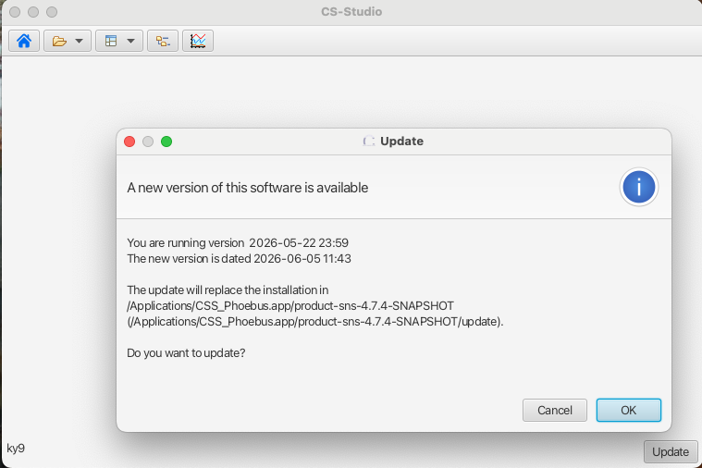
Update of office version
Offers self-update as new versions become available
There is no need to follow each of the frequent updates!
  If it ain’t broke…

Slide 4
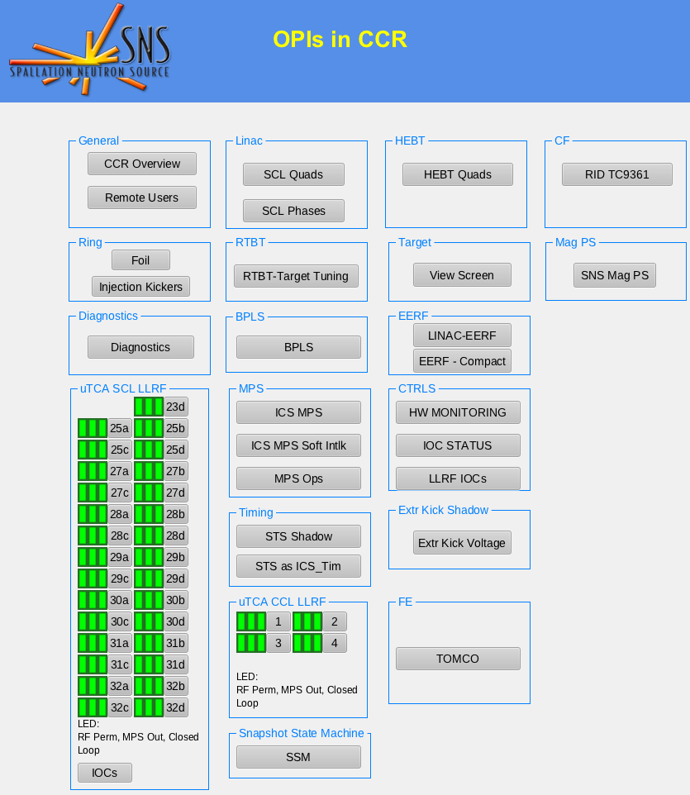
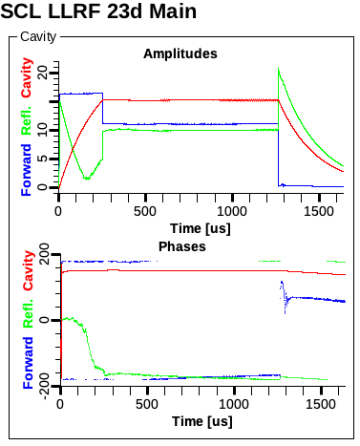
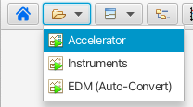
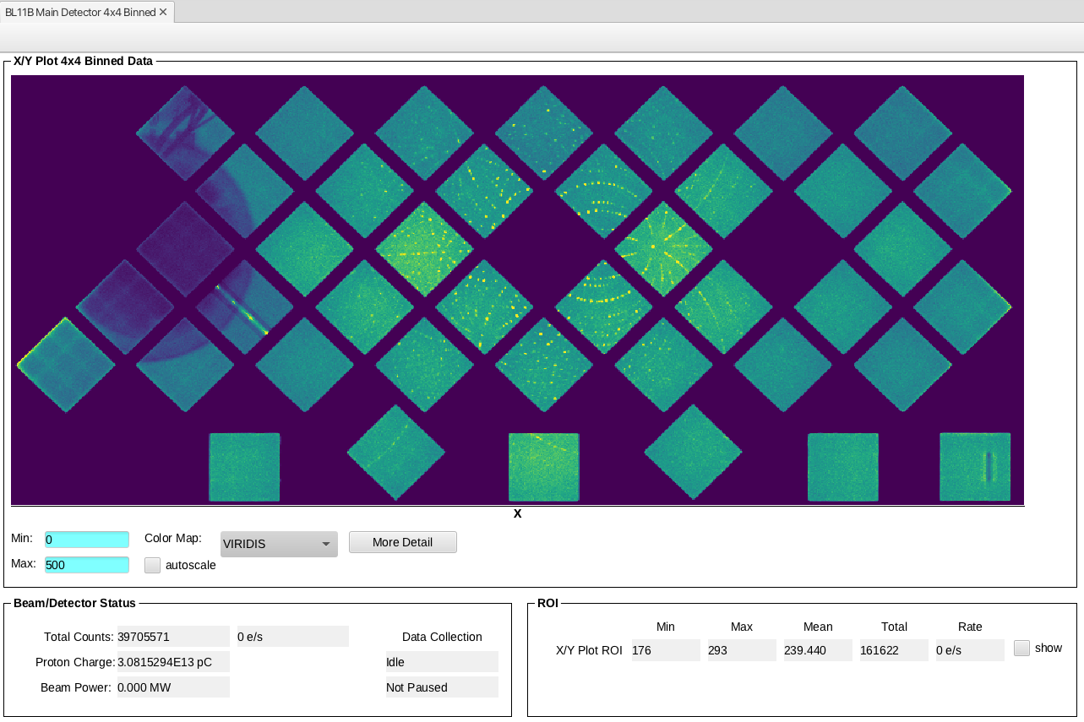
Start with ‘Home’ button or ‘Top Resources’ drop-down

Slide 5
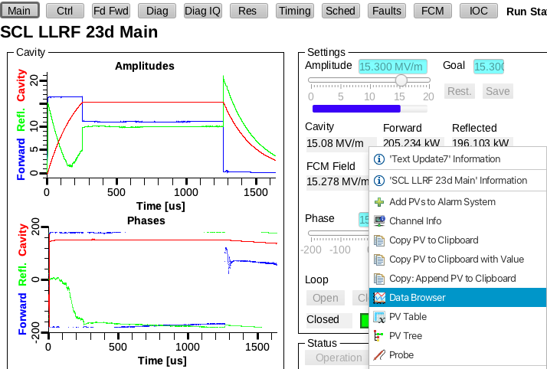
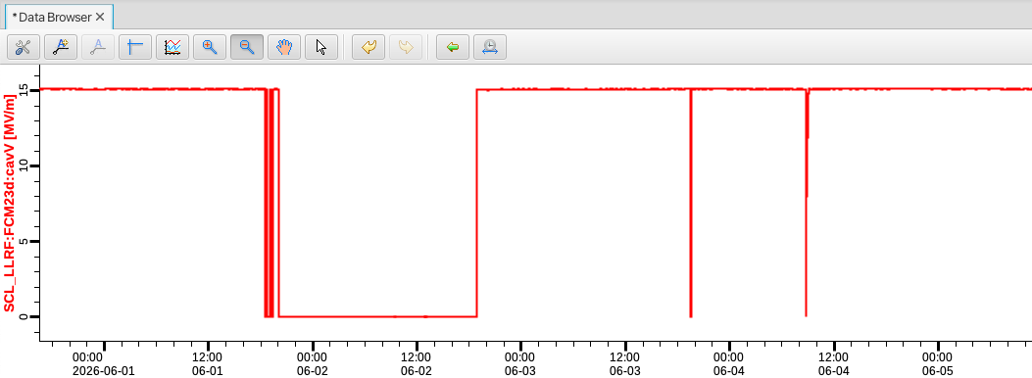
Archive Access
Note read-only controls unless we’re in control room

Slide 6
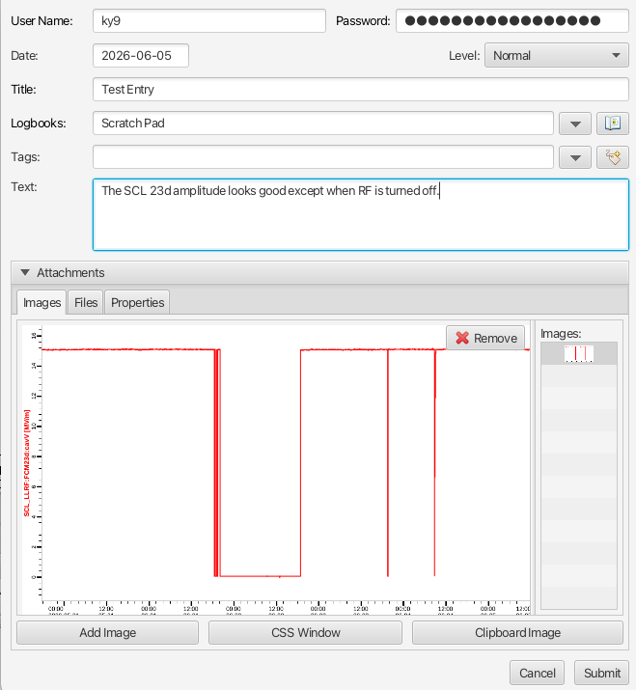
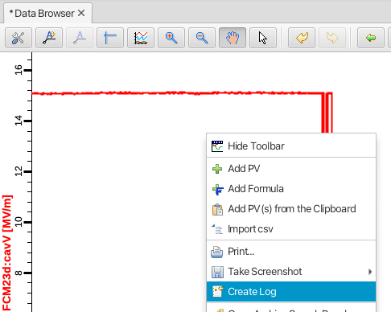
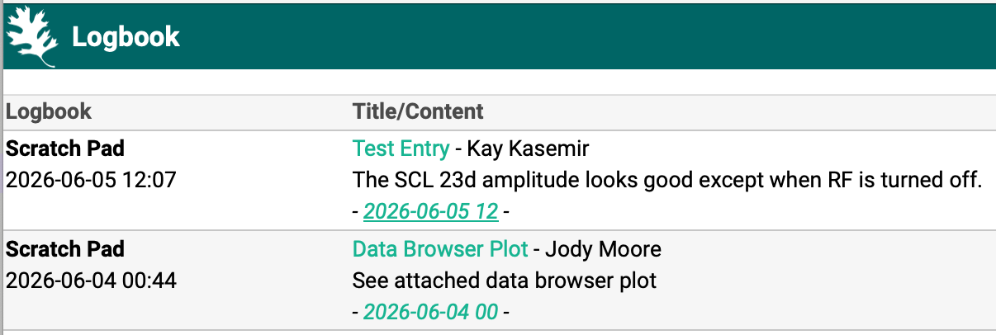
Logbook Support
”Create Log” from
Displays
Data Browser
Alarm Table (CCR)
Similar “email” option at beamlines,
but getting hard to support

Slide 7
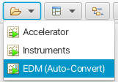
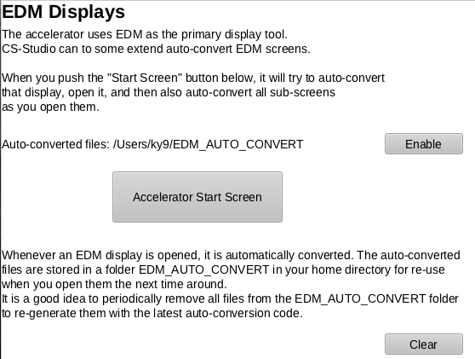
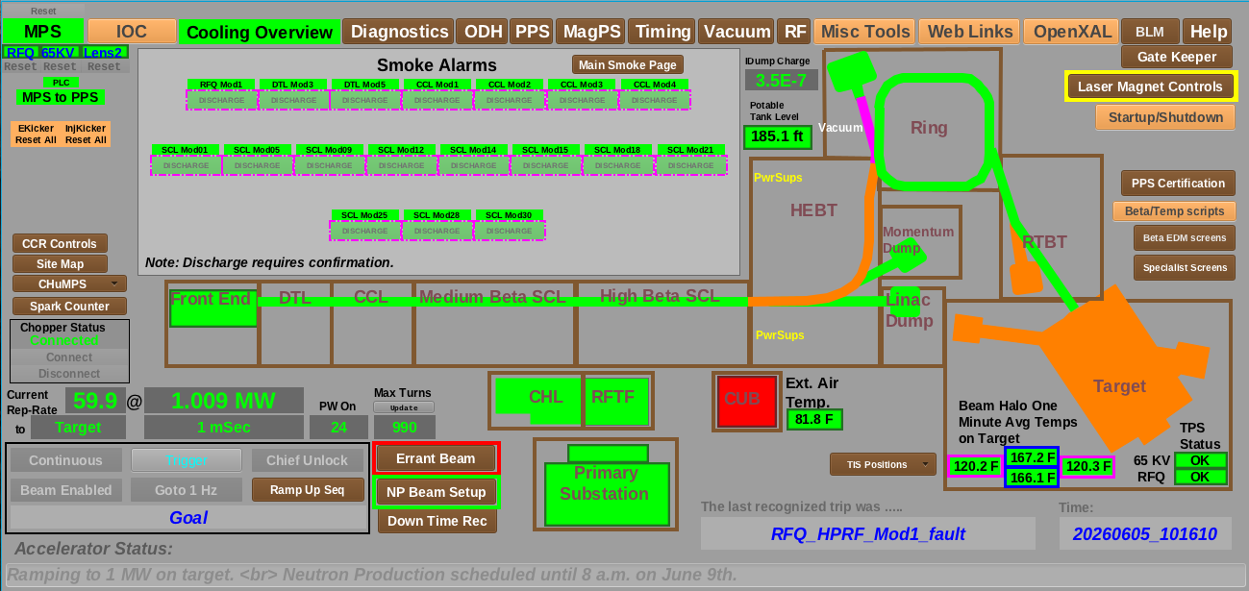
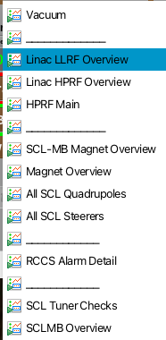
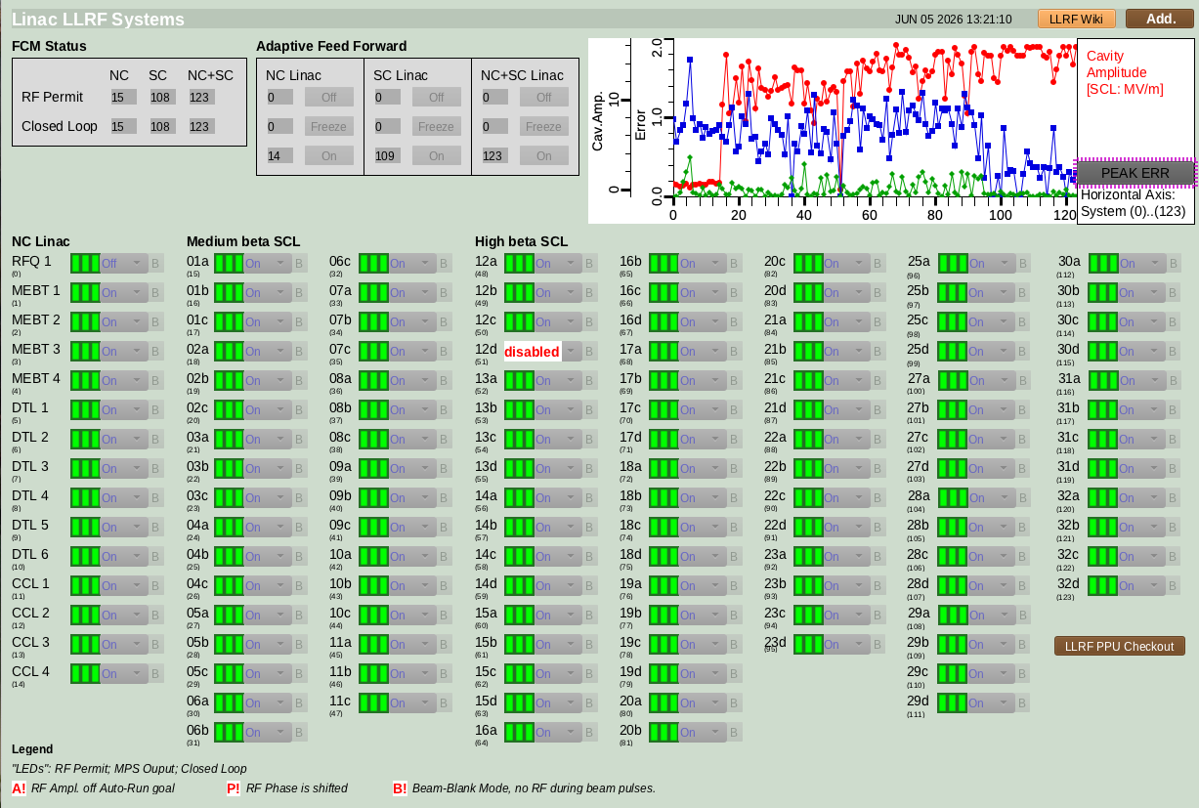
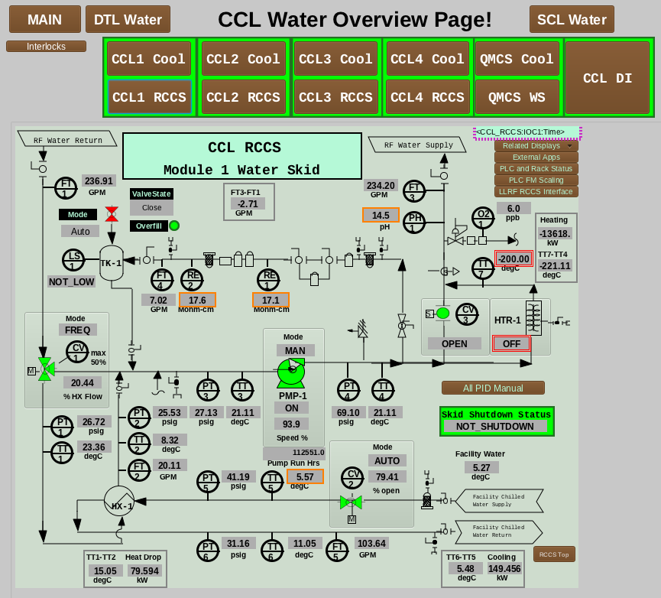
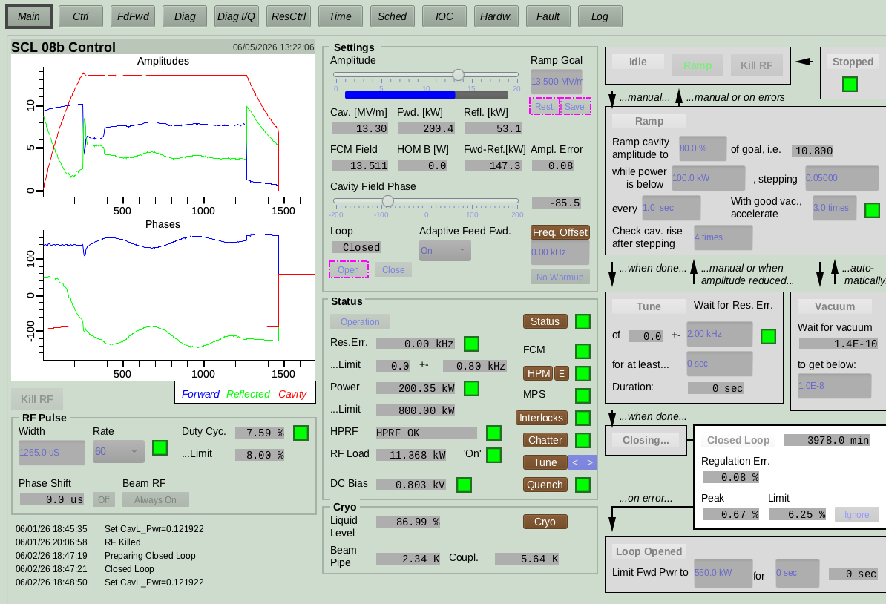
Auto-converted EDM Displays
Work on auto-converted displays is ongoing…

Slide 8
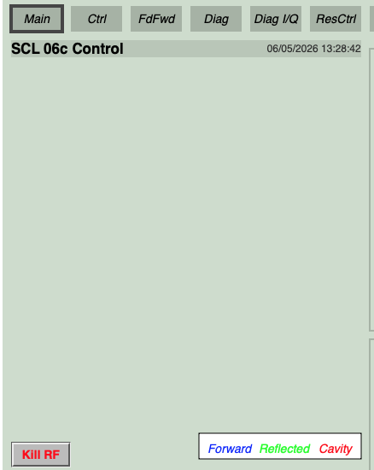
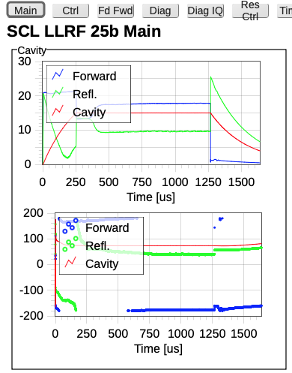
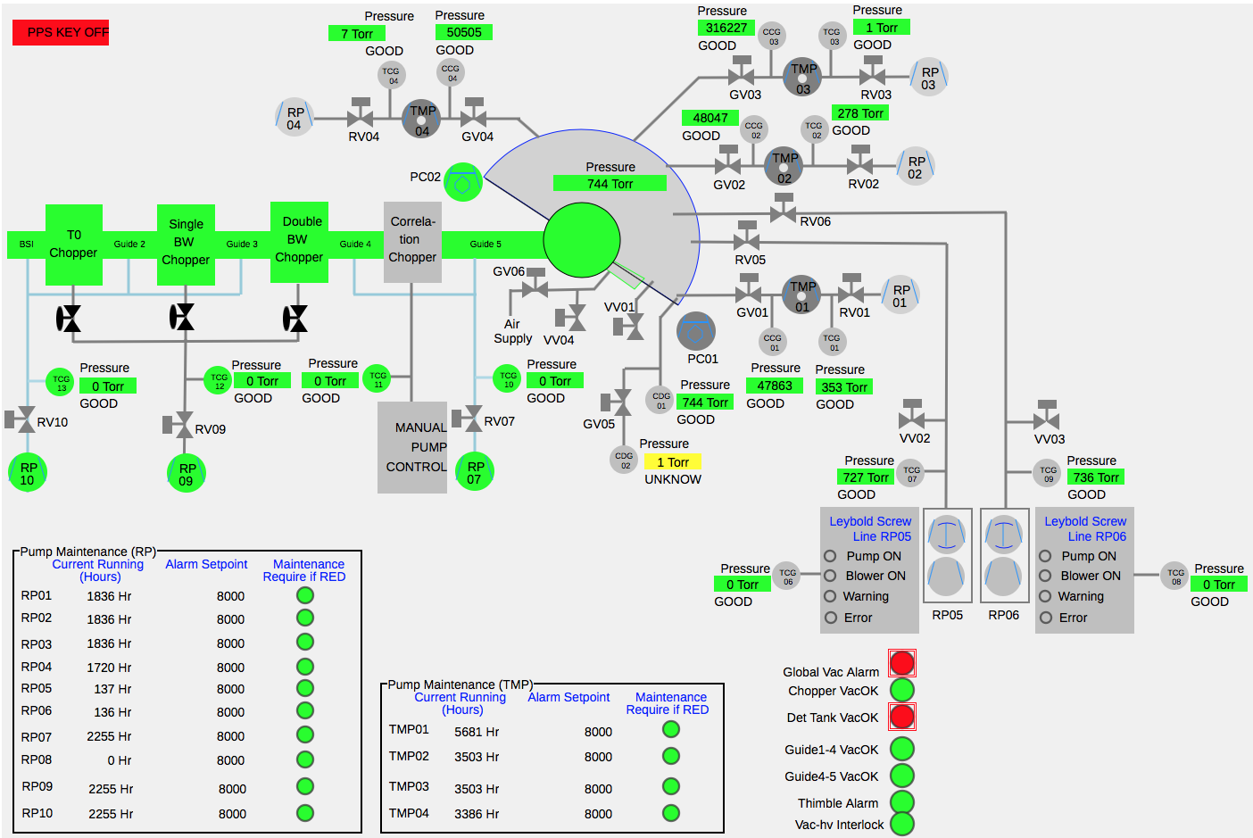
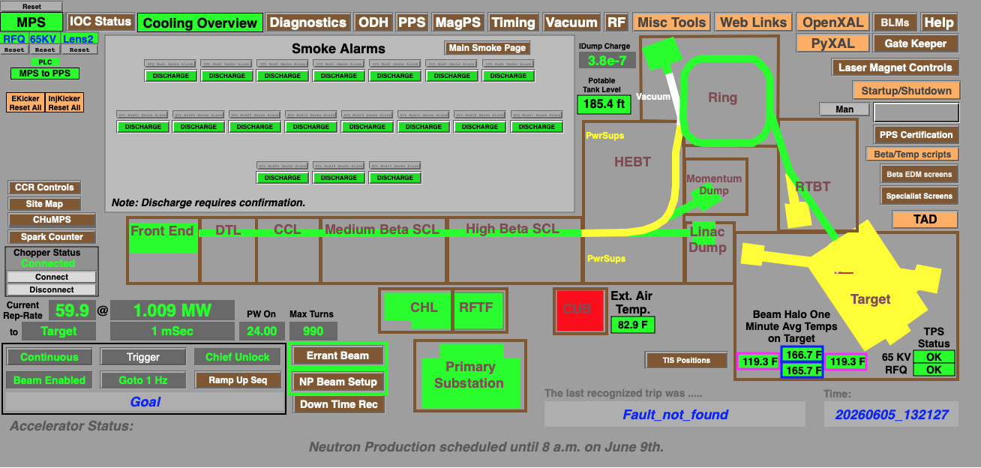
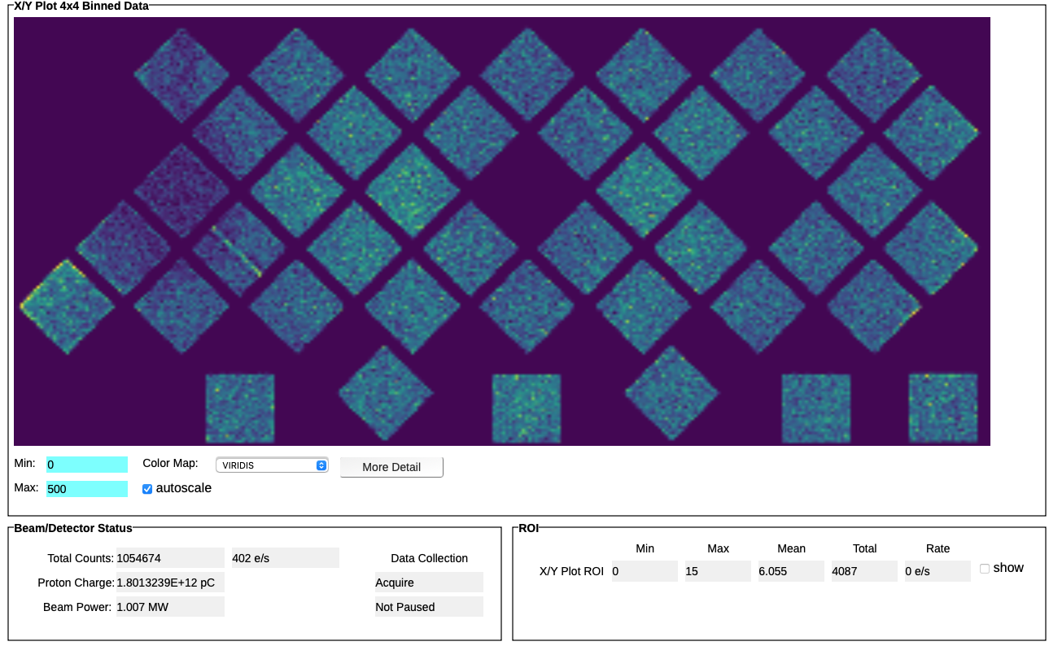
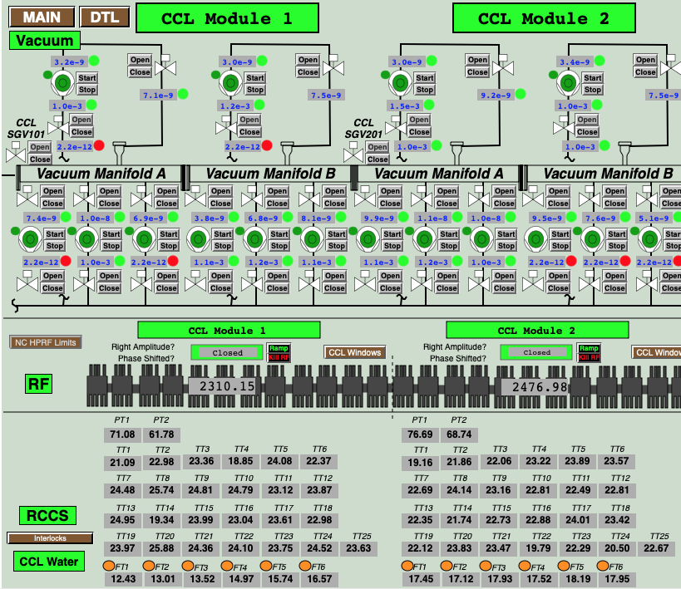
Web displays: Simpler, but easier to reach
EDM
https://controlssoftware.sns.ornl.gov/wedm
No waveforms (plots, images)!
Display Builder
https://controlssoftware.sns.ornl.gov/dbwr
No scripts!

